Slide 1
Strategies for Successful Implementation of Rural Community Advisory Boards
NithyaPriya Ramalingam, PhD,
Senior Analyst & Qualitative Core Lead, Oregon Rural Practice-based Research Network
Laura Campbell, MBA, MPH; Brittany Badicke MPH; Margaret McLain McDonnell, MPH; Mary Patzel, MBA; Emily Myers, MPH; Chrystal Barnes, MPH; Alex Moore MPH; Melinda M. Davis, PhD, MCR
Notes:
Presentation objectives: Study overview of our preliminary findings
Nithya background/credentials
Qualitative researcher within Oregon Rural Practice-based Research Network (ORPRN), a statewide network of primary care clinicians, community partners, and academicians dedicated to studying the delivery of health care, improving the health of Oregonians, and reducing rural health disparities
Work is participatory in nature. We are driven to understand and support community needs and priorities

Slide 2
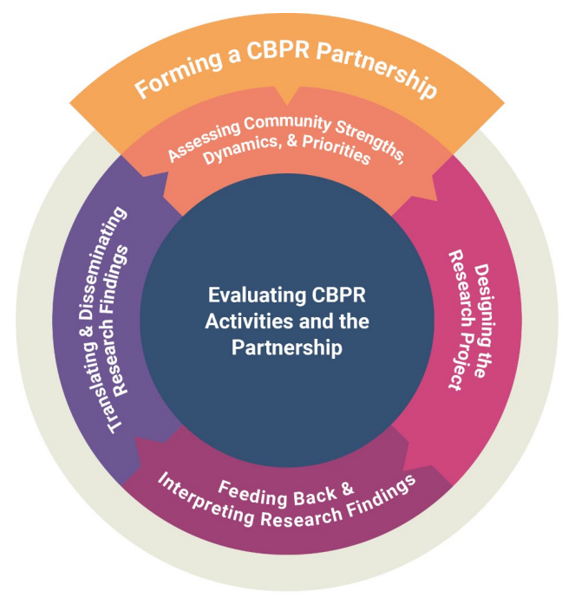
Background: Community Advisory Boards
Community Advisory Boards (CABs) are a key component of successful Community-Based Participatory Research (CBPR) projects
Mechanism for community members to have representation in research activities
CABs being utilized in non-CBPR projects
Increasing recognition of value of community engagement
Notes:
CABs are one way to apply CBPR in research projects—mechanism for community members to have representation in research activities. highlight this concept came out of CBPR, but lots of folks are using this model beyond CBPR - in community engaged research, but it's not always CBPR
Allowing projects to gather insights and information form the local population helps in better targeting resources and planning, and helps to ensure that interventions and programs better fit the communities and patients they are being developed for
Figure adapted from Barbara Israel six sequential phases:
Forming a CBPR partnership
Assessing community strengths, dynamics, and priorities
Designing the research project
Feedback and interpreting research findings
Disseminating and translating research findings
Theory behind CBPR/CABs focuses on community involvement in research, but little empirical guidance exists on how to effectively lead CABs, or recruitment and retention strategies

Slide 3
Background: CABs within our system
ORPRN has central advisory board to define program priorities
Several regional community boards to inform on community needs
10+ research advisory boards tied to individual projects
Notes:
-We wanted to tackle this question because within our programs we have numerous advisory boards, frequent comment/recommendation of AB within our proposals, understand what it takes to effectively run/sustain a CAB to better integrate them into our research work
- Oregon Rural Practice-based Research Network (ORPRN), a statewide network of primary care clinicians, community partners, and academicians dedicated to studying the delivery of health care, improving the health of Oregonians, and reducing rural health disparities
the Oregon Clinical and Translational Research Institute, a part of the National Center for Translational Sciences funded CTSA consortium that encompasses 50+ hubs around the country and provides a broad expanse of clinical and translational services to enhance the efficiency and quality of rigorously translating research ideas into impact
Could highlight that some of these boards are temporary (CES is like a day event), others are for study duration, and some are enduring
Therefore, the goal of this work was to identify best practices and challenges in executing community advisory boards, we developed case studies from advisory boards with ORPRN and OCTRI

Slide 4
Methods: Data Collection and Analysis
Sample: Five CABs from OCTRI and ORPRN
Data sources:
Semi-structured interviews
Meeting notes from CAB meetings
Rapid qualitative analysis produced narrative summaries
Summaries were reviewed to identify cross-cutting best practices
Journey mapping to anchor best practices to stages of CAB lifecycle
Notes:
CABs identified for this study supported partnered research, technical assistance, and education projects using five case examples: a statewide colorectal cancer technical assistance program, a rural veteran access to care research study, Project ECHO, wildfire smoke impact on prenatal and infant health project, and a cancer early detection study.
The interviews were designed to capture structure of CABs, changes over time, challenges, and best practices

Slide 5
Results: 4 Thematic Best Practices
Initiation
Planning
Project Execution
Continuation or Project Closure
1. Establishing clear purpose, goals, and expectations via collaborative decision-making and charter creation
3. Engaging a research team member with sufficient capacity to build and maintain a board
2. Increasing participation benefits via financial compensation and space to support members’ goals
4. Leveraging existing structures for related projects to balance meaningful engagement with limited time
Notes:
We anchored our themes/best practices to the stages of project lifecycle from the project management literature or the sequence through which a project progresses.
-We clustered the interview themes around these four stages, 4 best practices and 4 challenges were identified
Initiation: Funding for project secured, need for CAB established
Planning: Recruiting CAB members, developing plan for CAB structure and meetings
Project Execution: CAB meetings to inform and direct project work
Continuation or project closure: Dissemination of project findings, evaluation of CAB
Four best practices were identified:
Establishing clear purpose, goals, and expectations via collaborative decision-making and a subsequent charter;
increasing the benefits to participation via financial compensation and space to support CAB member’s personal and/or professional goals;
engaging a research team member with sufficient time and resources to build and maintain a board;
leveraging existing boards and structures when appropriate to balance meaningful engagement with the time burden of participating in a CAB

Slide 6
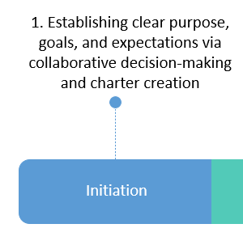
Best Practice #1: Establishing clear purpose, goals, and expectations
Keep this at the forefront, remind at each meeting, review regularly, and shift as needed
Define structured term lengths to provide clarity for AB members AND project team
Find the right meeting cadence that balances the needs of the project and the time available from AB members
Notes:
Things to identify/clarify:
Have a charter that people can refer back to for goals, time commitment, vision, responsibilities, etc. – review regularly and change as needed
How long do people stay on the board, how many meetings do they need to attend
CARAVAN: after the first year of AB, cleaner structures around term lengths, letting people bow out when they wanted to. This also allowed the research team to clarify when is recruitment season for AB, so appropriate time could be allocated to recruiting new members
Be clear about how much of AB members time is needed to participate – is it only advisory board meetings? Are there tasks they may be asked to do in between meetings? Is any in-person time expected? (this can be a barrier!)

Slide 7
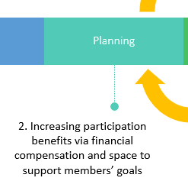
Best Practice #2: Increasing participation benefits
Financial compensation is important but not everyone can accept stipends or payment for their CAB work
Food during meetings
Internet access or tablets
Site visits to CAB members location
Including members as authors in publications
Providing opportunity for CAB members to get to know and connect with each other personally and professionally
Notes:
Site visits
Old school—channeling LJ, means a lot to show up—the physical trouble that someone gone to drive, get to know them and know how they are doing
Bi-directional effort, the research team is giving—we are listening to them
Providing opportunity for board members to get to know and connect with each other personally and professionally, an opportunity to share about their work and ask for support when needed
CARAVAN examples: research work directly ties into day to day work, AB can make connections with other organizations supporting Veterans, provide resources
Share events, communicate and promote

Slide 8
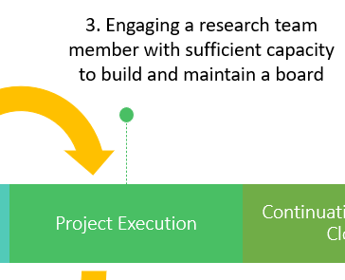
Best Practice #3: Engaging a research team member to build and maintain a board
Building and maintaining CAB takes time and effort!
Tasks to build and maintain an advisory board include:
Staying in contact with members outside of meeting and developing relationships
Scheduling & facilitating meetings
Developing agendas & meeting content
Coordinating compensation
Notes:
Some interviewees reported spending 10-20 hours prepping for each advisory board meeting. This does not include time spent relationship building etc.
CARAVAN example: developed pre-work videos to refresh members with content
pre-work was valuable to encourage the expectations that you are looking for a variety of voices, encourage during the meetings themselves, having a phone call or meet up before AB-work done, wy they are being invited, and perspective they bring to increase comfort—

Slide 9
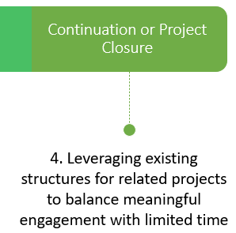
Best Practice #4: Leveraging existing structures for related projects
Considerable effort required to initiate and sustain CABs
Particularly salient in rural areas as local players or key partners may already be serving multiple roles
Consider leveraging one advisory board or existing groups for related projects to balance engagement with limited time
Notes:
Utlizied Advisory board for related project: leveraging existing structures to balance meaningful engagement with limited time; using one advisory board to talk about multiple projects (CORPs and Kansagara)--it’s labor intensive and take a lot of effort and energy—thinking in topic arenas or across
Also utilizing the overarching ORPRN AB to connect to subject matter experts for topic specific boards or feedback?

Slide 10
Conclusions
Four best practices identified
Well-defined expectations for participation and meaningful benefits for community members are essential to success
Investment of time and $$ is critical
Additional research is needed to explore
Impacts of variations in CAB structures
Similarities/differences between rural versus urban CAB
Effectiveness of the best practices described and perspectives of CAB members
Diverse partners make great research!
Notes:
Next step: interviews with CAB members to understand their perspectives
Drill down on variations in CAB structure
Subscription model with voting power
Recruitment of past participating clinics
Compare and contrast different models for CAB participation
Frequency of meetings (Single event, monthly, quarterly, or ad hoc)
Purpose of CAB
Length of service

Slide 11
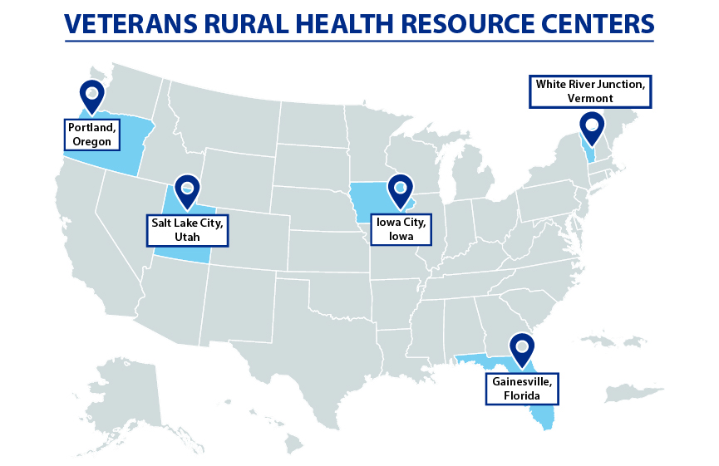
Acknowledgements
Funding from the Veterans Rural Heath Resource Center-Portland (Award # VRHRC-P, OMAT 15529)
PI: Melinda Davis, PhD
Study Team: Mary Patzel, Chrystal
Barnes, Alex Moore,
Victoria Sanchez, Nithya
Ramalingam

Slide 12
Thank you!
Nithya Ramalingam, PhD
ramalinn@ohsu.edu

Slide 13
Themes: Challenges
Initiation
Planning
Project Execution
Continuation or Project Closure
Identifying potential members who have time to participate without overburdening the same people
Maintaining momentum in the face of member turnover
Creating a diverse and representative board
Longevity and sustainability challenges due to funding and timelines
Notes:
Several challenges were identified across the five case studies:
identifying potential members who have time to participate and not relying on and overburdening the same people
creating a board that is diverse and representative of the population
maintaining momentum in the face of CAB member turnover,
longevity and sustainability challenges due to research funding and timelines,

Slide 14
Methods: Advisory Board Lifecycle
Initiation
Planning
Project Execution
Continuation or Project Closure
Funding for project secured, need for CAB established
CAB meetings to inform and direct project work
Recruiting CAB members, developing plan for CAB structure and meetings
Dissemination of project findings, evaluation of CAB
Notes:
We anchored our interview data to the stages of project lifecycle from the project management literature or the sequence through which a project progresses.
-We clustered the interview themes around these four stages, 4 best practices and 4 challenges were identified
Initiation: objective for your project, determine whether the project is feasible, and identify the major deliverables for the project
Planning: break down the larger project into smaller tasks, build your team, and prepare a schedule for the completion of assignments
Project Execution: Turning your plan into action
Continuation or project closure: Provide final deliverables & determine the success of the project

Slide 15
Results: CARAVAN Case Study
CARAVAN has investigated the research gaps surrounding rural Veterans experiences accessing VA and non-VA primary care services and update our understanding of the factors that impact non-VA clinics’ experience caring for rural Veterans. CARAVAN has been informed by a CAB since 2019.
Notes:
To illustrate some of the themes, I will share data from one case study, the CARAVAN project. CARAVAN is funded by the Veteran Rural Health Resource Center and seeks to examine rural Veteran experiences accessing VA and non-VA primary care services, and update our understanding of factors that impact non-VA clinics’ experience caring for rural Veterans
Advisory Board has been a part of the study since it’s initiation in 2019

Slide 16
Results: CARAVAN Case Study - CAB overview
Purpose:
Gain community perspective on research activities
Members:
Initially proposed as exclusively rural Veterans, membership evolved as project aims changed
Structure:
Hour long, quarterly meetings
Payment is available for CAB members
Notes:
Purpose: support with interpreting needs assessment, help with recruitment of right individuals for data collection
Membership: evolved to include clinic staff and community members providing services to Veterans
Overview of the CARAVAN AB structure, members, and goal

