Slide 1





Preventing “Tipping Points” in
High Comorbidity Patients:
A Lifeline from Health Coaches
PI: Jonathan N. Tobin, PhD (CDN/The Rockefeller University)
Co-PI: Mary Charlson, MD (Weill Cornell Medicine)
Funding:
PCORI Award #IHS-2017C3-8923
With support from:
AHRQ Grant #P30-HS-021667
NYC-CDRN (INSIGHT) PCRF Award #20171205
CAPriCORN PCRF Award #20171205

Slide 2

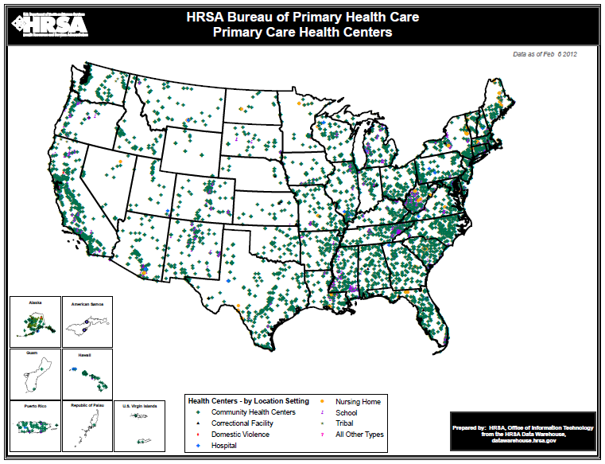
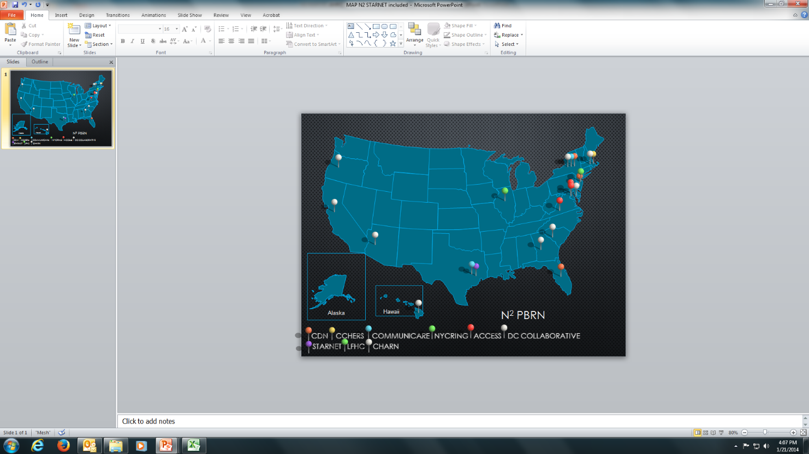

  CDN N² –PBRN: Building a Network of Safety Net PBRNs
CDN is A Practice-based Research Network (PBRN) that works with Federally Qualified Health Centers (FQHCs) and other Primary Health Care Safety-net Practices
DHHS – HRSA: The Primary Health Care Safety-Net
CDN N2-PBRN
1373 Grantees, 9,000 sites,
27 million patients
9 PBRNs,
600 sites,
4.5 million patients
CDN is an
AHRQ-designated
Center of Excellence for
Practice-based
Research
and Learning
Funded by AHRQ Grant: P30-HS-021667
PI: Jonathan N. Tobin, PhD (CDN)
www.CDNetwork.org

Slide 3

n²-pbrn
Scale-up model
N² -PBRN
CDRNs
PBRNs
FQHCs
CDN n²-pbrn has built a Scalable Research Infrastructure
to Serve the Needs
of Clinicians who Practice
in the Health Care Safety-net
by building on existing infrastructure,
creating new relationships
PROVIDING EXTERNAL PRACTICE FACILITATORS (ONLINE, REMOTE)
and dissemination channels
www.CDNetwork.org
Notes:
SCALE-UP MODEL:
Health Care Safety-Net
⬇
Community/Academic Research Partnerships
⬇
Clinician Engagement
⬇
eCME
⬇
EHR based research
⬇
Big Data/
Learning Health Care System

Slide 4
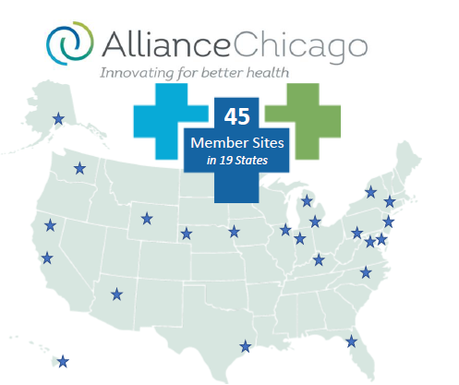
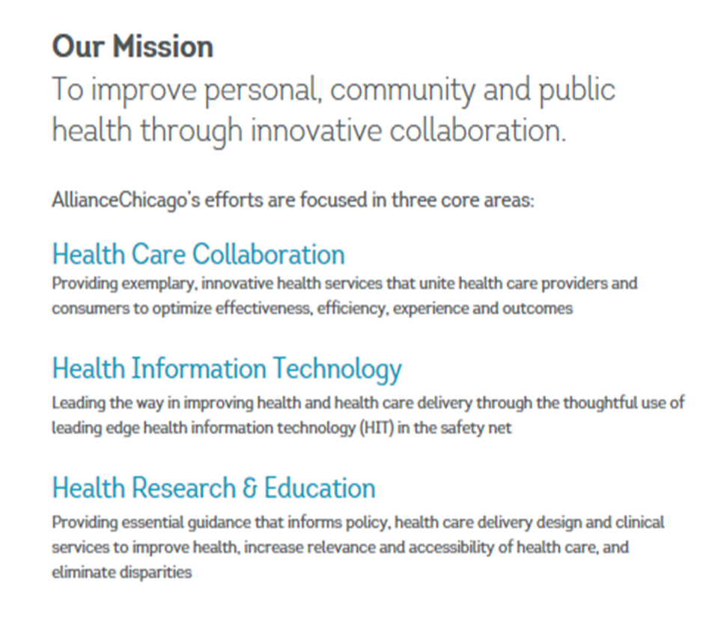
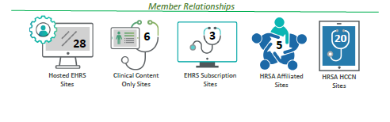
A centrally-hosted electronic health record solution for Community Health Centers
>2.6 Million: Unique, Active, Patients in Enterprise Data Warehouse (24% 18 and under)
Access to tools and services through subscription for other health centers who have alternative arrangements for hosting their EHR.
Quality Improvement, Strategic Planning, Research
www.alliancechicago.org

Slide 5


Chicago Health System Partners
Erie Family Health Centers
  Erie’s mission is to deliver high quality health care services to the Chicago region’s medically underserved residents with compassion, cultural understanding and respect—regardless of their ability to pay
  Provides healthcare to more than 70,000 patients a year at 13 sites spanning the west side of Chicago to Waukegan. These sites include four large primary care centers that offer integrated medical and dental health services, three additional large primary care centers, the region’s oldest and largest comprehensive teen and young adult health center, and five school-based health centers www.eriefamilyhealth.org
Friend Family Health Centers (FFHC)
  FFHC became an FQHC in 1998 and has focused on ensuring access to quality care in medically underserved areas
  Provide care services to over 30,000 patients on an annual basis
www.friendfhc.org

Slide 6


New York City Health Systems Partners
Community Healthcare Network (CHN)
  Provides more than 85,000 low-income and uninsured New Yorkers of all ages with an array of primary care, dental, nutrition, mental health and social services. CHN works in many communities where access to healthcare is limited
  Comprised of 14 FQHCs throughout Brooklyn, the Bronx, Queens, and Manhattan, along with a fleet of mobile vans
  www.chnnyc.org
Family Health Centers at NYU Langone (FHC-NYU)
  Provides medical assistance to an underserved population consisting of diverse, changing cultures such as the Hispanic, Chinese, Caribbean, Arab and Russian communities. The majority of people served by FHC-NYU includes those on Medicaid, the homeless, those who live in public housing, children, those who don’t speak English as a first language and those who wouldn’t otherwise have access to care.
  One of the largest FQHC networks in the nation that serves over 130,000 patients across its main site and 15 sites
  www.nyulangone.org/locations/family-health-centers-at-nyu-langone

Slide 7












PCORnet, the National Patient-Centered Clinical Research Network, is a tightly integrated partnership of 9 clinical research networks, 2 health plan research networks, coordinating centers, and a central office. Together, we can connect you to data for an unparalleled number of clinical trial-eligible patients.
MISSION
To conduct patient-centered and data-enabled clinical research to deliver results that matter, faster
VISION
Create a sustainable network that conducts patient-centered research and answers questions important to patients, caregivers, clinicians, and the broader healthcare community
www.pcornet.org

Slide 8


New York City Clinical Data Research Network or INSIGHT Clinical Research Network (INSIGHT CRN) was established to improve and streamline research in an effort to advance patient-centered research
Collects comprehensive medical histories for approximately 12 million patients while ensuring privacy and security of patients
Offers researchers and other users access to a de-identified database with clinical data on 4.5 million patients and 60 million encounters
http://www.nyccdrn.org/
Central Database
of 12 million Patients
Current Data:
EHR: 90M clinical encounters
Claims: Medicare, Medicaid, 1199
Social Determinant data
Future Data:
Other private claims data
Bio specimen data,
Registry,
Patient reported outcomes

Slide 9











Chicago Area Patient-Centered Outcomes Research Network (CAPriCORN) is an unprecedented collaboration of 10 healthcare systems in the Chicagoland region
This network seeks to address the needs of an estimated 9.5 million residents, including groups that experience significant health inequities partly due to variable access to high-quality care.
Developed an adaptable common data model and a master data protocol to longitudinally characterize over 1 million patients
http://capricorncdrn.org/

Slide 10

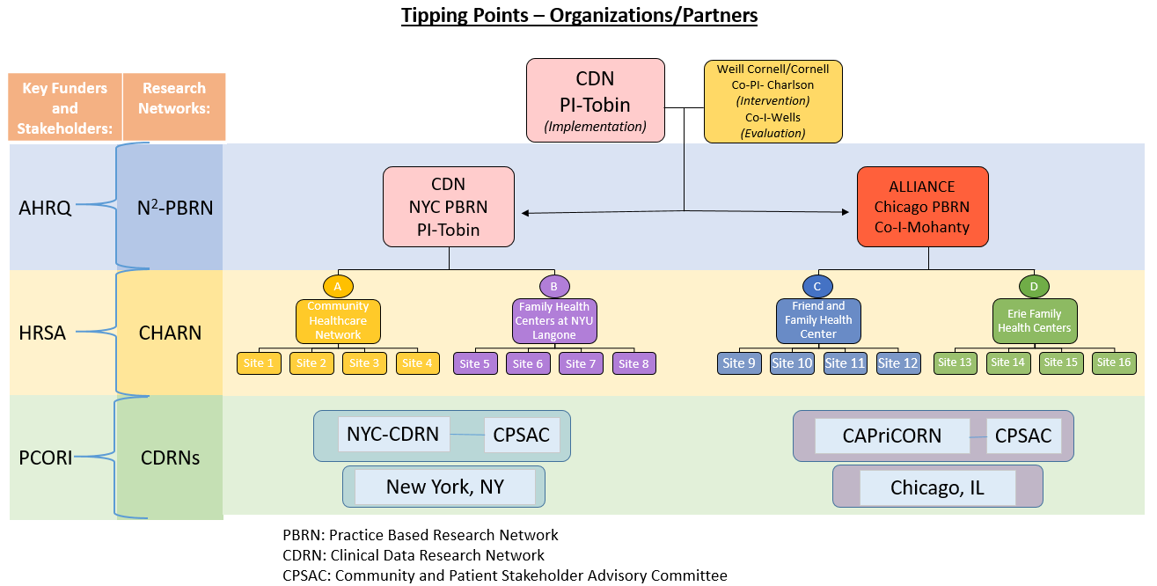

Slide 11
Tipping Points - Background
Patients with Multiple Chronic Diseases:
  Increased mortality and morbidity
  High risk for destabilization, including hospitalization, ER visits and increased disability
  Excluded from clinical trials because they have worse outcomes, confounding results
  Almost no guidelines for the care of such patients
  Experience social and psychosocial challenges which may lead to “Tipping Points” resulting in de-stabilization, which can lead to unplanned hospital and ED admissions

Slide 12
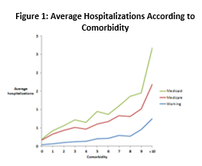
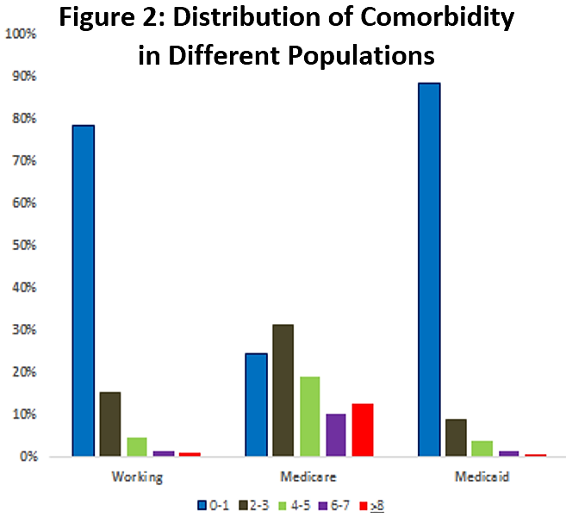
Tipping Points - Background
Notes:
Patients with CCI > 4 have a broad array of chronic conditions. If diseases are grouped by systems (diabetes, COPD, cardiovascular, liver, rheumatic, ulcer, cancer, and depression), a Medicaid population with a CCI >4 had 127 different combinations of conditions. Creating subsets of patients with specific combinations of MCDs is complex, and multiple disease-management protocols, each with a list of separate guidelines, is unmanageable.

Slide 13
Tipping Points - Background
  Funded by PCORI from 01/01/19-12/31/23
  Cluster Randomized Clinical Trial (cRCT)
  For patients with multiple chronic diseases
    Charlson Comorbidity Index (CCI) >4

Slide 14
Tipping Points – Research Team
Clinical Directors Network (CDN):
Jonathan N. Tobin, PhD
Andrea Cassells, MPH
Shelly Sital, MPH
Dena Moftah
TJ Lin, MPH
Weill-Cornell Medicine:
Mary E. Charlson, MD
Erica Phillips, MD
James P. Hollenberg, MD
Rosio Ramos
Martin Wells, PhD
Lewis L. Perin, MS
AllianceChicago:
  Fred Rachman, MD
  Nivedita Mohanty, MD
  Roxane Padilla, BS

Slide 15
Tipping Points – Practice Settings
Predominantly low-income, black and Latino/a adult patients with multiple chronic diseases (defined by Charlson Comorbidity Index of >4)
    Conduct recruitment, assessment and intervention at 4 FQHC networks (Health Systems in NYC and Chicago) through designated, trained Health Coaches:
      Family Health Centers at NYU Langone (NYC)
      Community Healthcare Network (NYC)
      Erie Family Health Center (CHI)
      Friend Family Health Center (CHI)
Engage 4 FQHC sites in each Health System with at least 500 patients who have high comorbidity at each Health System (16 FQHC sites)

Slide 16
Tipping Points – Patients
Charlson Comorbidity Index (CCI)
Weighted Measures of Chronic Diseases:
Condition | Points
Myocardial infarction | 1
Congestive heart failure | 1
Peripheral vascular disease or bypass | 1
Cerebrovascular disease or transient ischemic disease | 1
Hemiplegia | 2
Pulmonary disease/ asthma | 1
Diabetes | 1
Diabetes with end organ damage | 2
Renal disease | 2
Mild liver disease | 2
Severe liver disease | 3
Gastric or peptic ulcer | 1
Cancer (lymphoma; leukemia; solid tumor) | 2
Metastatic solid tumor | 6
Dementia or Alzheimer’s | 1
Rheumatic or connective tissue disease | 1
HIV or AIDS | 6
Hypertension | 1
Skin ulcers/ cellulitis | 2
Condition | Points
Depression | 1
Warfarin | 1
Any transplant: renal; heart; liver; bone marrow; lung | 6
Inflammatory bowel disease | 1
Sickle cell disease | 3
Hemophilia | 3
Muscular dystrophy | 2
Developmental delay | 2
Mental retardation | 2
Down’s syndrome | 3
Cystic fibrosis | 3
Tay Sachs | 3
Cerebral palsy | 2
Uncontrolled seizures | 3
Autism | 3
Schizophrenia or bipolar | 3
Bipolar disease | 3
Taking antipsychotics or medications for bipolar disorder | 3
Drug or alcohol addiction | 3

Slide 17
ClinvestiGator – Study Database System
Web based complete data entry, reporting and statistical and graphical analysis system.
  APACHE, PHP, MySQL
High levels of security HIPPA compliant; site specific and role specific access; full audit trail
Baseline and follow up data entered extracted directly from FQHC/Health Systems EHR data into ClinvestiGator and reviewed by Health Coaches
Real time and dynamic reports to track recruiting, follow-up and missing data
Integration of outcome data (hospitalizations and emergency dept visits) from PCORnet CDRNs and Regional Health Information Organizations (RHIOs)

Slide 18
Tipping Points – Patients
Charlson Comorbidity Index (CCI) Distribution
FQHC Network/Health System | Total # of Adult Patients | Total # of Patients with CCI ≥4 | % of Patients with CCI ≥4
Health System 1 | 46,475 | 8,238 | 17.7%
Health System 2 | 81,254 | 4,766 | 5.9%
Health System 3 | 33,524 | 3,640 | 10.9%
Health System 4 | 28,311 | 2,132 | 7.5%
Total | 189,564 | 18,776 | 9.9%

Slide 19
Tipping Points - Intervention
Control: Patients will receive their usual care at their health center per Patient-Centered Medical Home (PCMH) guidelines
Experimental: Patients will receive their usual care at their health center per Patient-Centered Medical Home (PCMH) guidelines
plus health coaching

Slide 20
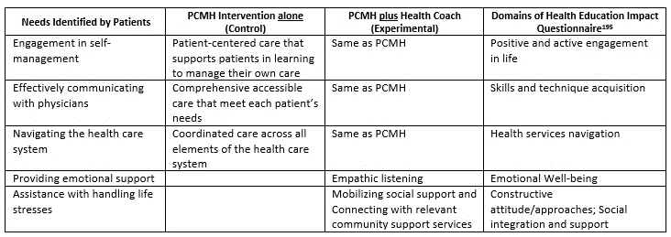
Tipping Points – PCMH versus
PCMH with Health Coaching (PCMH+)

Slide 21
Tipping Points - Intervention
Experimental Arm Includes:
Setting life goals and self-management goals with Health Coaches to engage patients
Coaching toward self-management goals shared with patient’s primary care clinician and Health Coach to work with patient to develop an action plan for when they should contact their clinician
Emotional and tangible support for life stresses Patients in the PCMH+ coaching intervention will be able to contact the Health Coach if they need help because of new life events, psychosocial challenges, new diagnoses or deterioration in their current social or clinical status. The Health Coach can help to mobilize family and friends to provide support

Slide 22
Case Example: 70 y.o. AA woman prior hx of stage II breast cancer NED on aromatase inhibitor, with hypertension,
Type II diabetes and osteoarthritis secondary to obesity. Patient experienced a fall stepping of the bus 2 week ago
and since then still feels achy. She went to the ED and was told there were no fractures. During the baseline interview with the health coach the patient expresses the desire to lose weight to take the pressure of her knees and thus lower her chance of falling again.
? frequency
? frequency
? frequency
PCMH
3 months
12 months
24 months
Contact often triggered by
appointments or clinical events
Contact often triggered by
appointments or clinical events
Follow-up call to assess pain
Medications prescribed by ER or PCP for pain
Review fall risk ; need for assistance device
Coordinate care with physical therapy or pain management if needed
PCMH + HC
3 months
12 months
24 months
Monthly coaching call
Referrals to free or reduced cost
community based nutrition
and physical activity classes
Calls initiated by
participant only
Bi-weekly coaching call
on lifestyle modification
to achieve weight loss goals

Slide 23
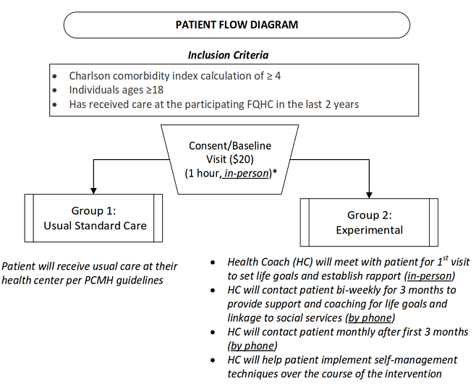

Slide 24
Tipping Points - Key Demographics
 | NY/Chicago FQHC Prevalence Rate (%) | Subgroup Sample Size
Total (As Proposed) |  | 1920
Race/ethnicity
White | 20.8% | 344
Black | 48.5% | 1006
Hispanic | 42.2% | 659
Insurance
Medicaid | 62.3% | 1169
Medicare | 5.1% | 115
Other Private | 13.3% | 259
Uninsured | 19.3% | 376
SES
<100% FPL | 80.8% | 1649
<200% FPL | 94.5% | 1837
Health Literacy
Language other than English | 23.6% | 394

Slide 25
Tipping Points - Outcomes
Primary Outcomes
Decreased unplanned hospitalization (data from CDRNs, Healthix, Azara, & MRAIA/IDPH)
Decreased disability (WHODAS)
  Demonstration that ‘tipping points’ are
  more often triggered by psychosocial issues than by medical issues
Secondary Outcomes
Decreased emergency department visits (data from CDRNs, Healthix, Azara, & MRAIA/IDPH)
Improved Patient-reported Outcomes:
  Increased patient activation (PAM-13)
  Increased self-management (HEI-Q)
  Increased patient satisfaction (CAHPS)
Assessments
T₀= Baseline; T₁= 6-months post baseline; T₂= 12-months post baseline; T₃= 24-months post-baseline

Slide 26
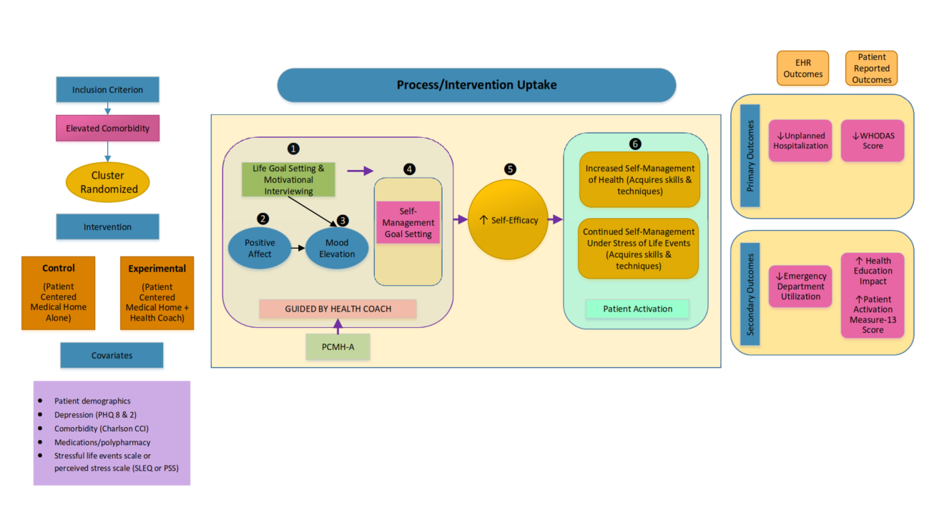
Tipping Points - Logic Model

Slide 27
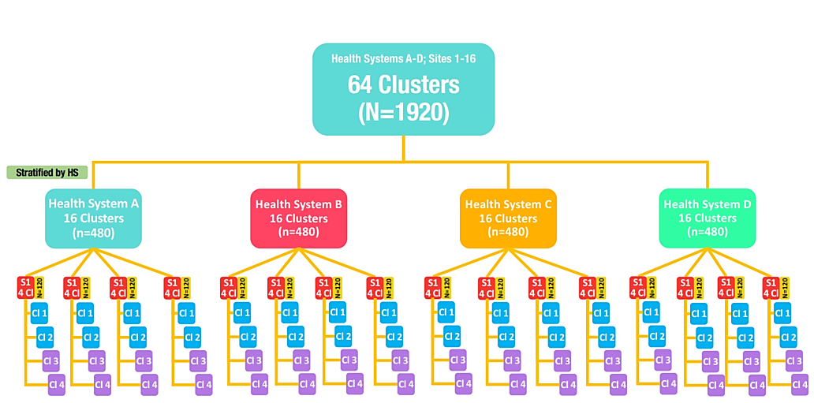
Recruitment & Randomization Design
N = 1920

Slide 28
Dissemination
Charlson Comorbidity Index (CCI)
Corresponding Conditions Addressed by
PCORnet Patient-Powered Research Networks (PPRNs )
Co-Morbidity | PCORnet PPRNs
Myocardial infarction | Health eHeart
Congestive heart failure | Health eHeart
Peripheral vascular disease | Health eHeart, V-PPRN
Cerebrovascular disease | Health eHeart, V-PPRN
Dementia | Health eHeart, iConquer MS, Alzheimer's PPRN, REN, IAN, MOOD, PMS_DN
Chronic pulmonary disease | COPD PPRN; SAPCON
Rheumatic disease | AR-PoWER, PARTNERS
Peptic ulcer disease | IBD Partners, IMPROVECARENOW
Mild liver disease | IBD Partners, IMPROVECARENOW
Diabetes without chronic complication | Health eHeart, NEPHCURE
Diabetes with chronic complication | Health eHeart, NEPHCURE
Hemiplegia or paraplegia | iConquer MS, Alzheimer's PPRN, REN, IAN, MOOD, PMS_DN
Renal disease | NEPHCURE
Any malignancy, Including lymphoma and leukemia, except malignant neoplasm of skin | ABOUT
Co-Morbidity | PCORnet PPRNs
Moderate or severe liver disease | IBD Partners, IMPROVECARENOW
Metastatic solid tumor | ABOUT
AIDS/HIV | PRIDEnet; PI CONNeCT
Any transplant: renal; heart; liver; bone marrow; lung | Health eHeart, NEPHCURE
Inflammatory bowel disease | IBD Partners, IMPROVECARENOW
Sickle cell disease | CENA, PEDSnet
Hemophilia | CENA, PEDSnet
Muscular dystrophy | DuchenneConnect, PEDSnet
Developmental delay | PEDSnet
Mental retardation | PEDSnet
Down’s syndrome | CENA, PEDSnet
Cystic fibrosis | COPD PPRN , CENA, PEDSnet
Tay Sachs | CENA, PEDSnet
Cerebral palsy | CENA, PEDSnet

Slide 29
Tipping Points - Conclusions
Most interventions have been focused on improving outcomes in patients with chronic disease using guidelines, protocols and process measures
BUT most interventions have not reduced hospitalization
  Because patients with ONE chronic disease do not drive hospitalization
  Patients with multiple chronic disease or “high comorbidity” do drive hospitalization
There are no guidelines for patients with multiple comorbidity
We need to give patients tools and support and the reason to believe that they can achieve their OWN life goals by learning to better manage their own MULTIPLE chronic diseases, and support them through multiple psychosocial crises they face

Slide 30
Jonathan N. Tobin, PhD
President/CEO
Clinical Directors Network (CDN)
Co-Director, Community-Engaged Research
The Rockefeller University
Center for Clinical and Translational Science
212-382-0699 ext 234
JNTobin@CDNetwork.org
www.CDNetwork.org

Slide 31
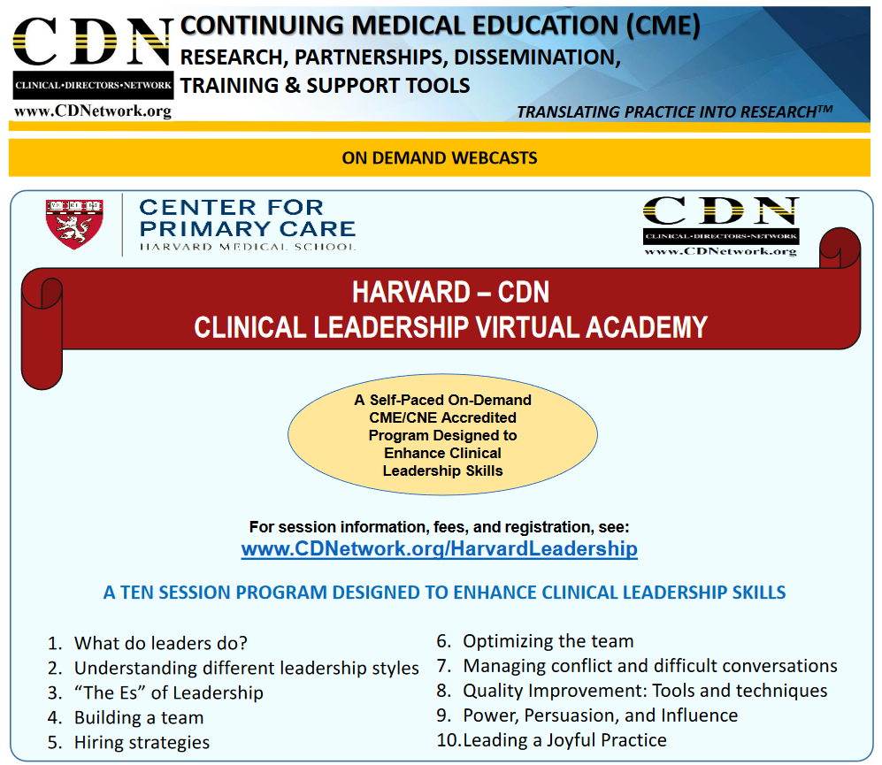
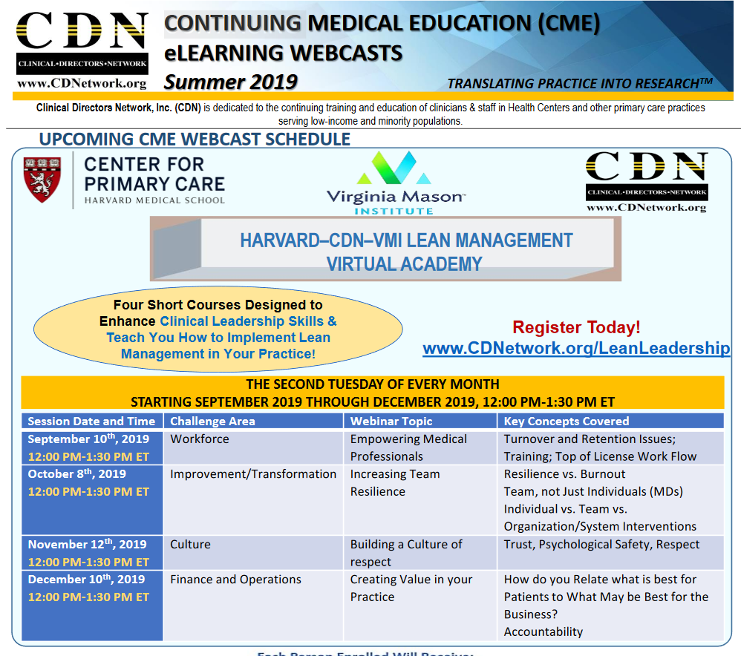
CDN Harvard Clinical Leadership Training
To Register and View Courses, visit www.CDNetwork.org

Slide 32
Tipping Points - Study Measures
Construct/Topic of Interest | Measure/Instrument | Patient | Data Source | Collection Time Points | Denominator
PRIMARY EFFECTIVENESS OUTCOME
Reduction of unplanned hospitalizations | Electronic feed | x | Survey, *EHR (Sites, Clinical Data Research Network, and data partners) | T0, T1, T2, T3 (via surveys at baseline, 6-,12-, and 24-months *Ongoing monthly ascertainment of a hospitalization during the 24-month study period per patient | All patients
Decreased WHODAS (World Health Organization Disability Assessment Scale) | Survey | x | Survey | T0, T1, T2, T3 (via surveys at baseline, 6-,12-, and 24-months | All patients
SECONDARY EFFECTIVENESS OUTCOMES
Patients in heath coaching plus intervention will have greater engagement in self-management | Survey | x | Survey | T0, T1, T2, T3 (via surveys at baseline, 6-,12-, and 24-months | All patients
Reduced Emergency Department visits | Medical Record | x | EHR (Sites, Clinical Data Research Network, and data partners) | Ongoing monthly ascertainment of a ED event during the 24-month study period per patient | All patients
T0= Baseline; T1= 6-months post baseline; T2= 12-months post baseline; T3= 24-months post-baseline

Slide 33
Construct/Topic of Interest | Measure/Instrument | Patient | Data Source | Collection Time Points | Denominator
MEDIATORS
Patient Activation | Patient Activation Measure (PAM) 13, | x | Survey | T0, T1, T2, T3 | All patients
Health Education Impact (HEI) | Health Education Impact (HEI) Questionnaire³ | x | Survey | T0, T1, T2, T3 | All patients
Emergency department visits | Medical Record | x | EHR (Sites, Clinical Data Research Network, and data partners) | Ongoing monthly ascertainment of a ED event during the 24-month study period per patient | All patients
Standard assessment (see co-variates below) | Survey | x | Survey | T0, T1, T2, T3 | All patients
COVARIATES, MODERATORS, AND/OR CONFOUNDERS
Depression | PHQ 8 | x | Survey | T0, T1, T2, T3 | All patients
Comorbidity | Charlson Comorbidity Index calculation | x | Survey | T0, T1, T2, T3 | All patients
Medications/ polypharmacy | Medication list | x | EHR | T0, T1, T2, T3 | All patients
Stressful life events scale or perceived stress scale | SLEQ or PSS | x | Survey | T0, T1, T2, T3 | All patients
Patient Demographics | Age, Sex, Race, Ethnicity, Income, out of pocket prescription costs, Travel time and method, Cell Phone type, Changes in clinician/site, Marital/partner status, Insurance status, Language | x | Survey, EHR | T0, T1, T2, T3 | All patients

Slide 34
Health Coach Training Manual
LEVEL 1 (Assessors + Interventionists)
Project Description
Research in human subjects
The Health Insurance Portability and Accountability Act of 1996 (HIPAA)
Privacy and Security Rules
Project Promotion
  Best methods to promote the study at the sites
  Initiation of the project at the sites
  Identify those who will be the champions of the project
Participant engagement and recruitment
  Recruitment and consenting script
  Role playing on how to approach potential participants
  Role playing on how to obtain informed consent form and HIPAA
Interviewing participants
  Baseline Enrollment surveys
  Tips on how to collect baseline information
  Role playing on how to collect baseline surveys
LEVEL 2 (Interventionists Only)
Delivering the intervention using
  Life Goal Setting
    Discuss their life goals, what they would like to achieve?
  Behavioral Contract/positive affect/self affirmation intervention
    A step in achieving the life goal
  Navigating available resources
    Provide participants with a list of resources available to them
  Community Mapping
    Provide participants with their community resources
  Problem Solving:
    Define the Challenges and solutions
  Motivational Interviewing
    Patient Center, what works for them?
Follow-up Assessments
  Intermediate assessments for the project
Adverse Events
  What is an “adverse event” (AE)?
  Procedure and time frame to report an AE
  Data collection in ClinvestiGator
Healthcare System: Know the health system and institutions

