Slide 1
SaFETy score as a predictor of gun violence in adolescent / young adult patients in a primary care setting
Sanjay Batish¹, MD; Anna Gilbert²; Cory Lutgen³; Elisabeth Callen³, PhD
¹Batish Family Medicine; ²MedServe; ³AAFP National Research Network
This research was made possible through an award from the American Academy of Family Physicians Foundation and the support of the American Academy of Family Physicians National Research Network

Slide 2
The Research Question
Primary Research Question
Is the SaFETy questionnaire a valid predictor of gun violence in a non-urban primary care setting?
Secondary Research Questions
Can adolescents be screened for gun violence exposure in a non-urban primary care setting?
Can PCP’s have an active role in reducing the gun violence epidemic?

Slide 3
Research Design and Method I
Figure 1: Location of Participating Clinics
Roanoke Chowan Community Health Center
Study Design: 6-month longitudinal, quantitative, survey-based study
Setting: four non-urban primary care clinics Participants: adolescent patients ages 14-24 Variables: SaFETy score and other assessments/survey questions and demographics, gun violence exposure Analysis: Mann-Whitney U, Wilcoxon Signed Rank
Limitations : small sample size, limited time frame (6-months vs. 24-months)
Piedmont Adult & Pediatric Medicine Associates
Cabarrus Rowan Community Health Centers
Batish Family Medicine

Slide 4
Research Design and Method II
Figure 2: SaFETy Score
Single Survey, issued at baseline and follow-up (6-months)
Measures:
SaFETy Score (4-item predictor of gun violence exposure)
ACEs: Adverse Childhood Experiences (physical and emotional abuse, neglect, and household dysfunction experienced in childhood)
6-month Violence Exposure
Lifetime Community Exposures
Parental Support
Conflict resolution beliefs (retaliatory attitudes)
Peer influence
Firearm Behavior
Resilience
Demographics
SaFETy Acronym | Question | Scale | Contribution
 |  | 0 (never) | 0
 | In the past 6 months, including | 1 (once) | 1
Serious Fighting | today, how often did you get | 2 (twice) | 1
 | into a serious physical fight? | 3 (3-5 times) | 1
 |  | 4+ (6 or more times) | 4
Friend Weapon Carrying | How many of your friends have carried a knife, razor, or gun? | 1 (none) 2 (some) 3+ (many, most, or all) | 0 0 1
Community Environment | In the past 6 months, how often have you heard guns being shot? | 0 (never) 1 (one or twice) 2 (a few times) 3 (many times) | 0 0 0 1
 | How often, in the past 6 | 0 (never) | 0
Firearm Threats | months, including today, has | 1 (once) | 3
 | someone pulled a gun on you? | 2 (twice or more) | 4

Slide 5
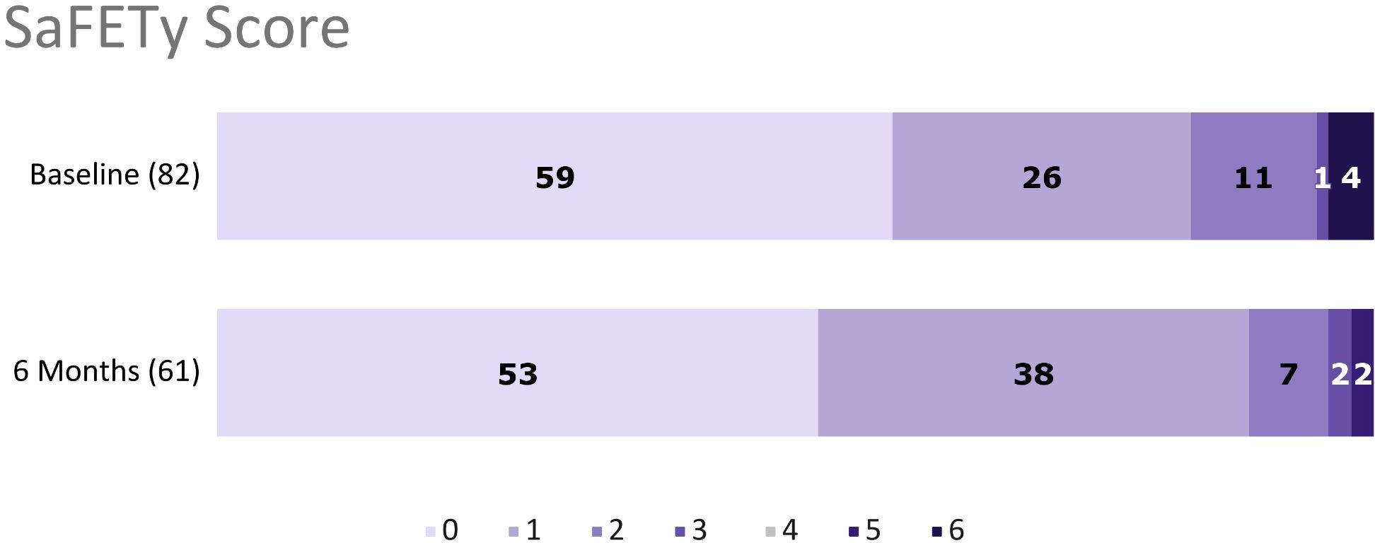
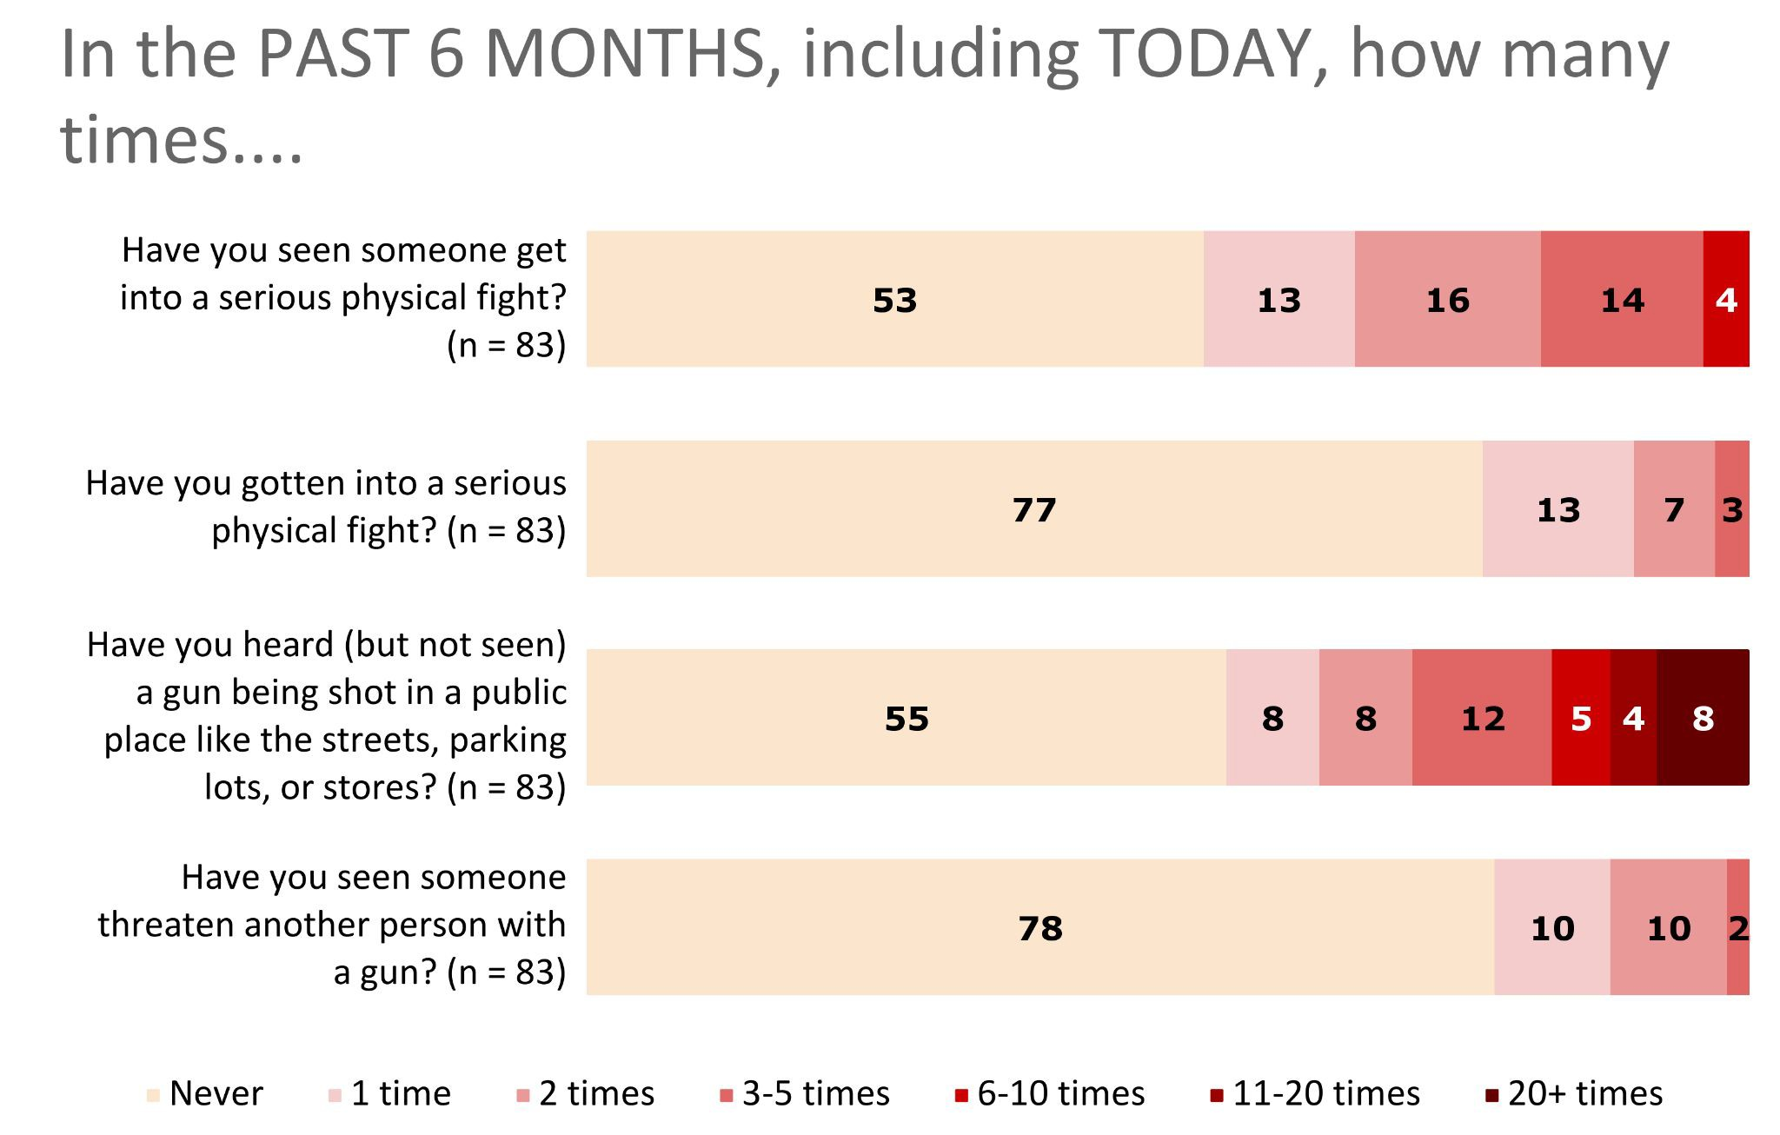
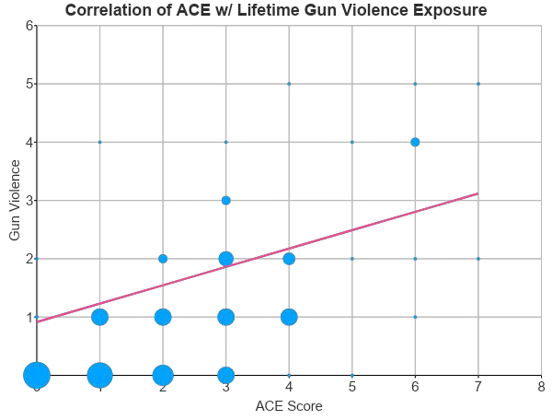
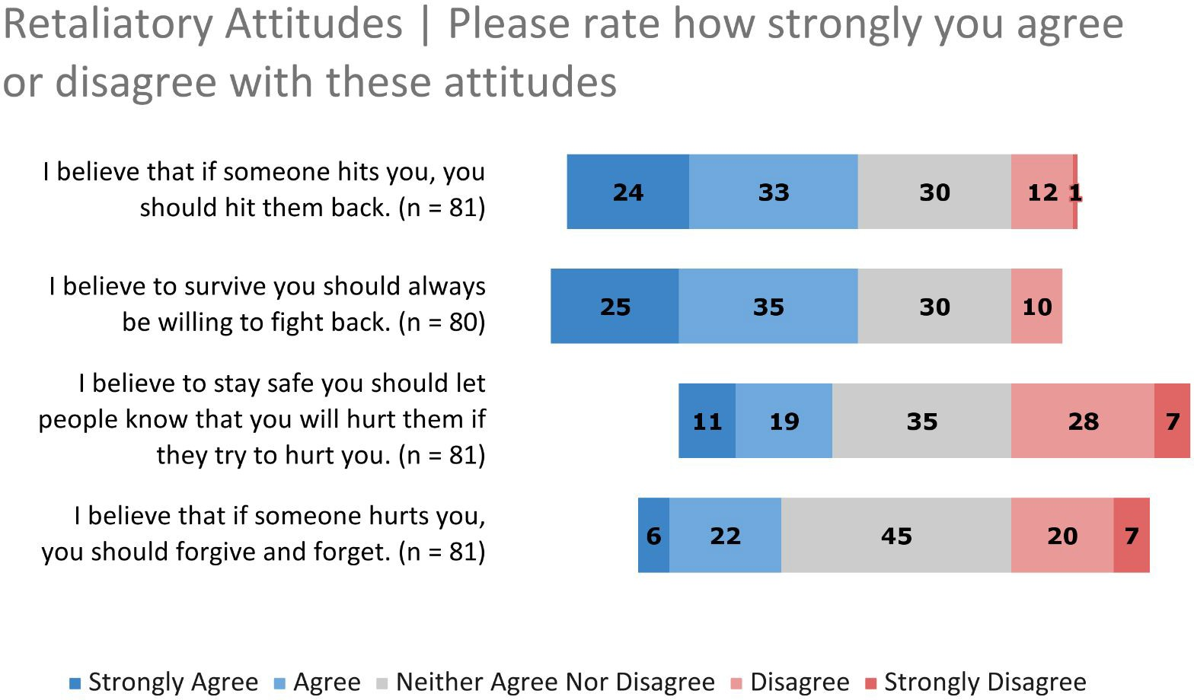
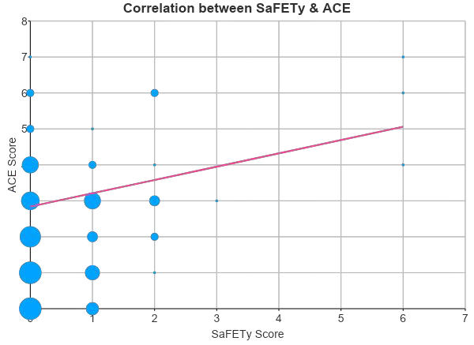
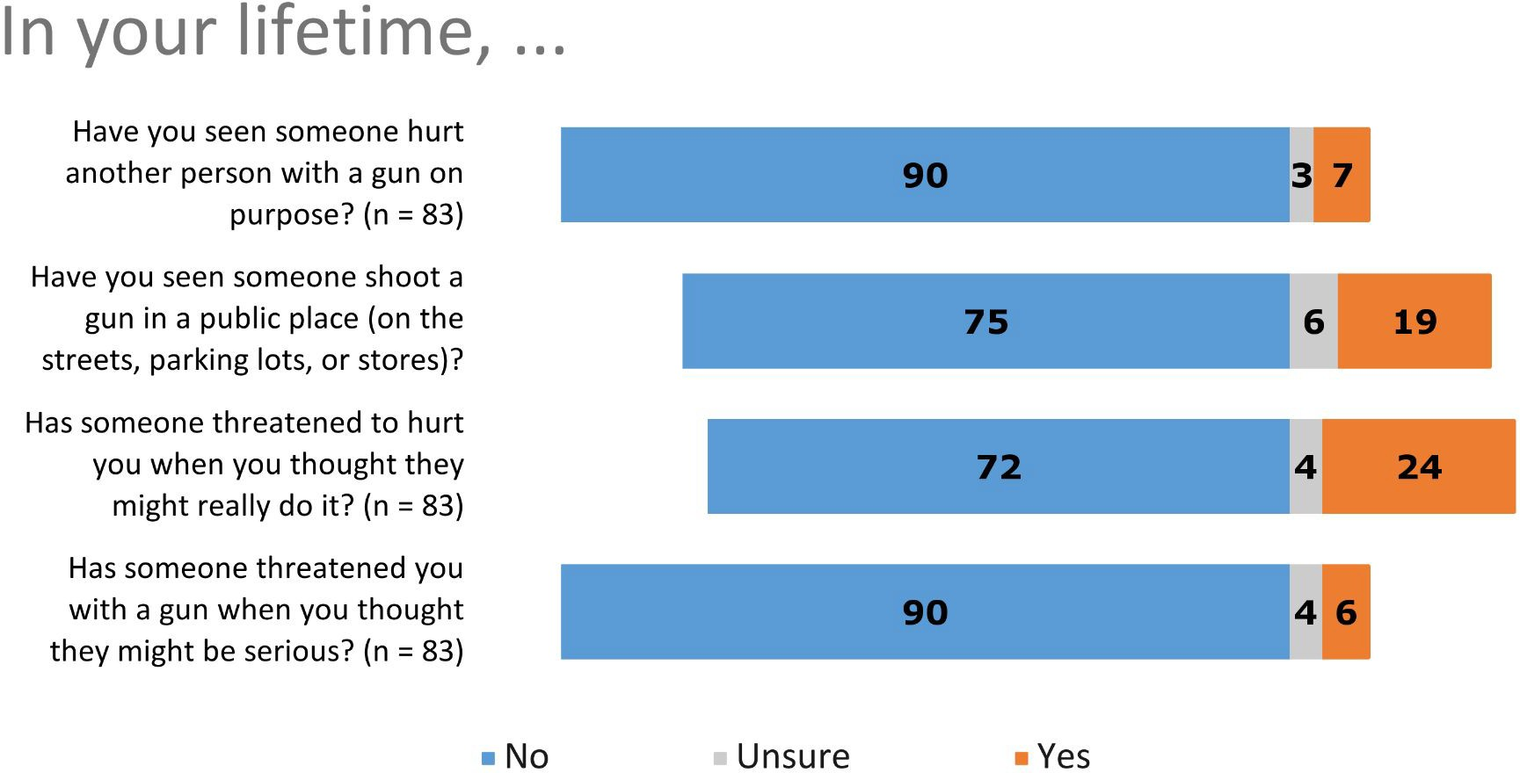
What the Research Found
Rates of violence exposure were similar in our population and the original SaFETy study which was conducted in an urban ED setting
Positive correlation between ACEs, the SaFETy Score, and Lifetime Gun Violence Exposure
No significant change in an individual’s level of gun exposure over 6 months
The belief in retaliating vs forgiving a perceived transgression ratio is 2:1 in our study population

Slide 6
What this means for Clinical Practice
Family Physicians have a role to play in the gun violence epidemic
This pilot study shows that screening adolescents for gun violence exposures or other related determinants is possible in a primary care setting
Further research with a larger sample size and longer study duration is needed to validate the SaFETy score in this population and setting

Slide 7
Optional: Add citation if work is published

