Slide 1
The Research Question
What factors influence use of delayed prescribing in primary care in the UK, and what is their relative importance?
Delayed prescribing (DP) has been shown to be effective in reducing unnecessary antibiotic consumption
Physician creates a prescription, but advises the patient to ‘wait and see’ whether the antibiotics are needed

Slide 2
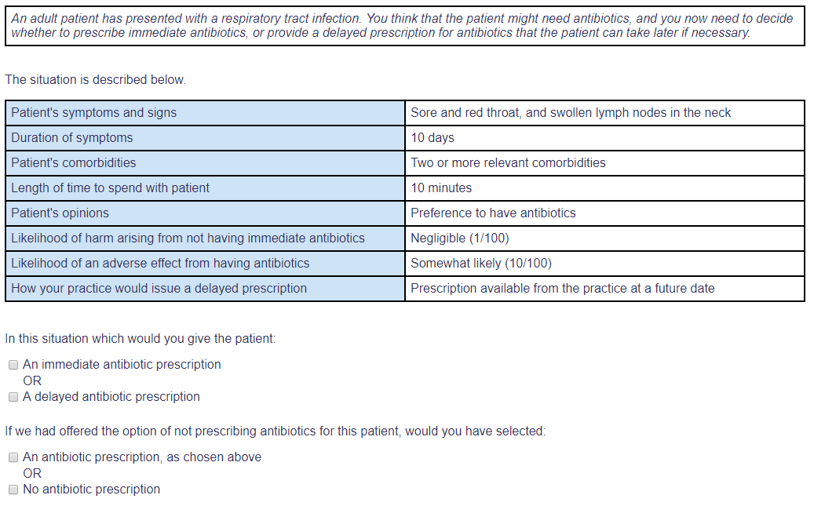
Research Design and Method
A stated choice study among UK primary care practitioners (general practitioners, GPs)
Presented GPs with a series of 15 prescribing scenarios, for a patient with a respiratory tract infection
Scenarios described by 8 attributes of the patient’s condition, and the discussion in the consultation
Choice of immediate, delayed, or no antibiotic prescription
Analysed using ordered logistic regression
161 GP respondents

Slide 3
Research Design and Method
SETTING
ATTRIBUTES
same in all scenarios
LEVELS OF THE ATTRIBUTES
vary in each scenario
CHOICE QUESTIONS

Slide 4
What the Research Found
Identified a continuum from immediate prescription to none
Clinical features are the strongest factors in determining location on the prescribing spectrum
DP occupies a poorly defined, intermediate position – constant level despite changes in presentation
minor
serious
Patient preference affected the choice of prescription type, but not the decision whether to prescribe
Individual practitioner preferences accounted for variation in prescribing strategies

Slide 5
What this means for Clinical Practice
Variation: some GPs more averse to reduced prescribing than might be expected from clinical evidence and guidelines
Some practitioners oppose DP – need for further research to understand objections, and identify alternative routes to safe reductions in antibiotic use
Importance of eliciting patient preference
Particularly, expressing preference not to have antibiotics, or neutral opinion

